Slide 1
FRESHFOOD A Grocery Website
Arun Kumar Singh
04917704421
MCA 4A

Slide 2
Introduction
This food grocery website project aims to create an online platform through which customers can buy product from their houses and can save their time.
Customers will be able to add items to their shopping cart, update quantities, and securely proceed to checkout.
Customers can also check their transaction history and can update their personal detail.
This “FreshFood” grocery website developed using PHP, AJAX offers an enhanced and dynamic shopping experience for users.
AJAX enables us to update parts of a web page without refreshing the entire page, PHP allows us to create dynamic web pages and interact with databases.
User can pay for an order through paypal gateway. But first he need to fill their order detail in checkout page.

Slide 3
Features
Login and Registration
Order and category view
Add/delete product from cart
Checkout
Transaction history
Create new admin
Update/delete/add category
Update/delete/add order and products

Slide 4





Technology Used

Slide 5
Screenshots Of Website

Slide 6
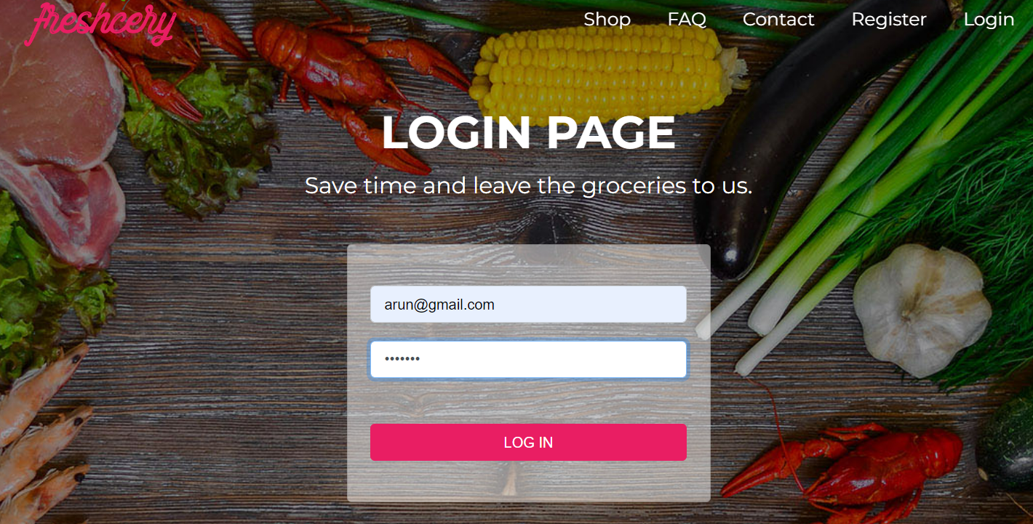
Fig 1 : login page

Slide 7
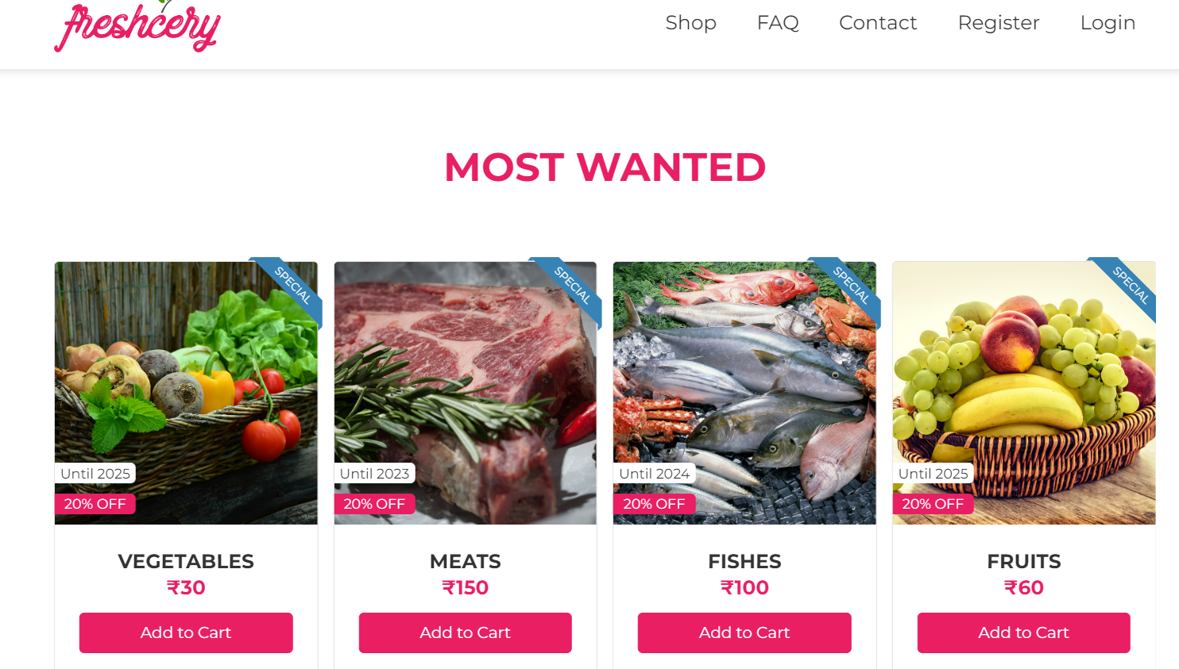
Fig 2 : shop page

Slide 8
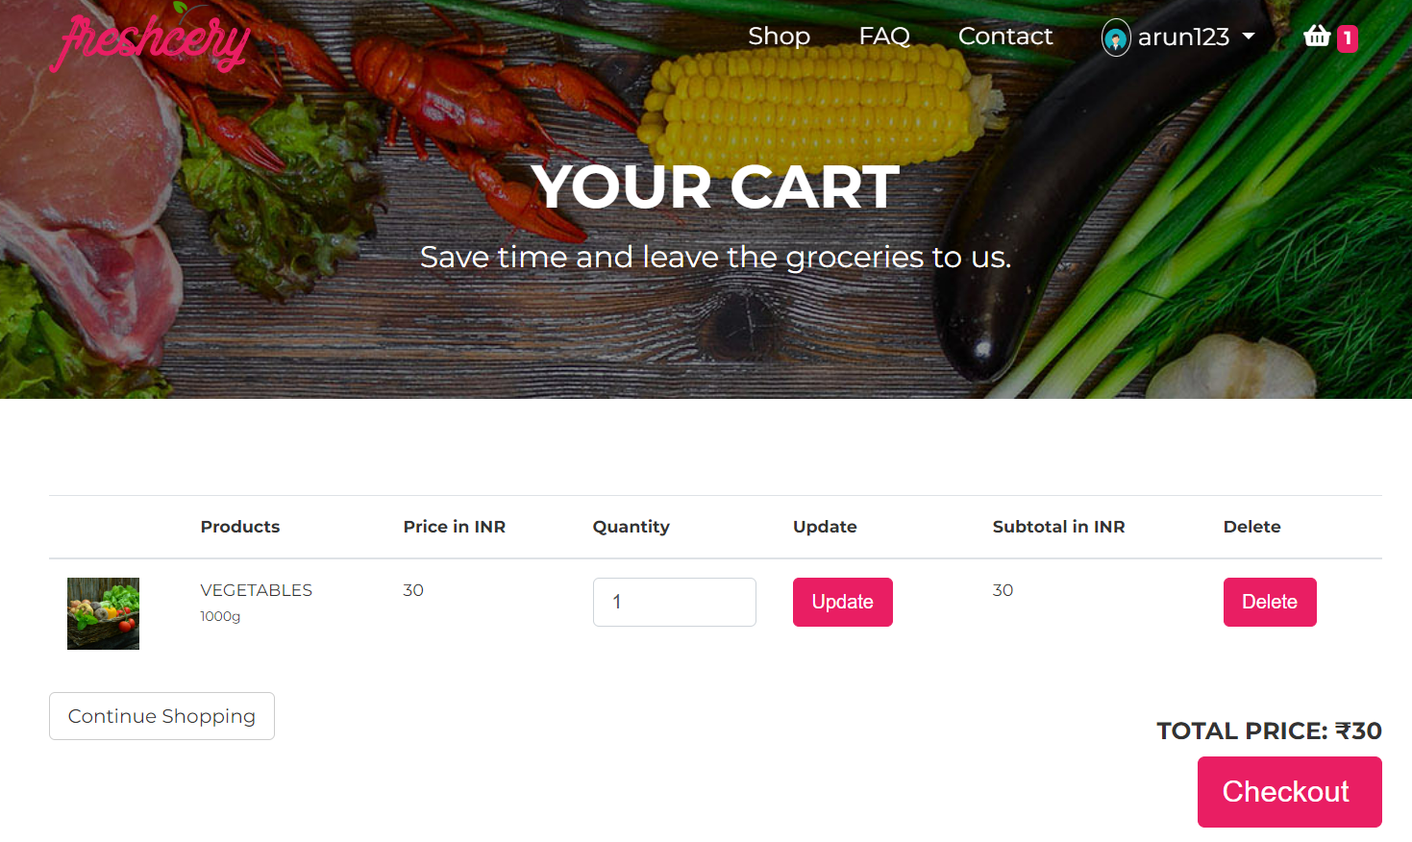
Fig 3 : cart page

Slide 9
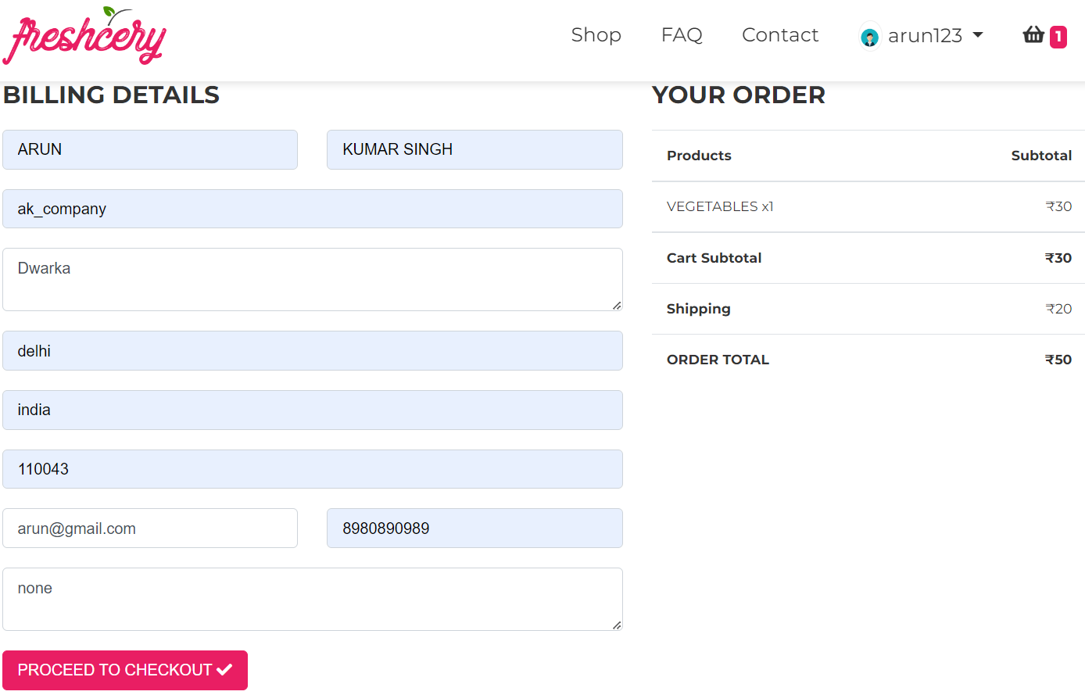
Fig 4: checkout page

Slide 10
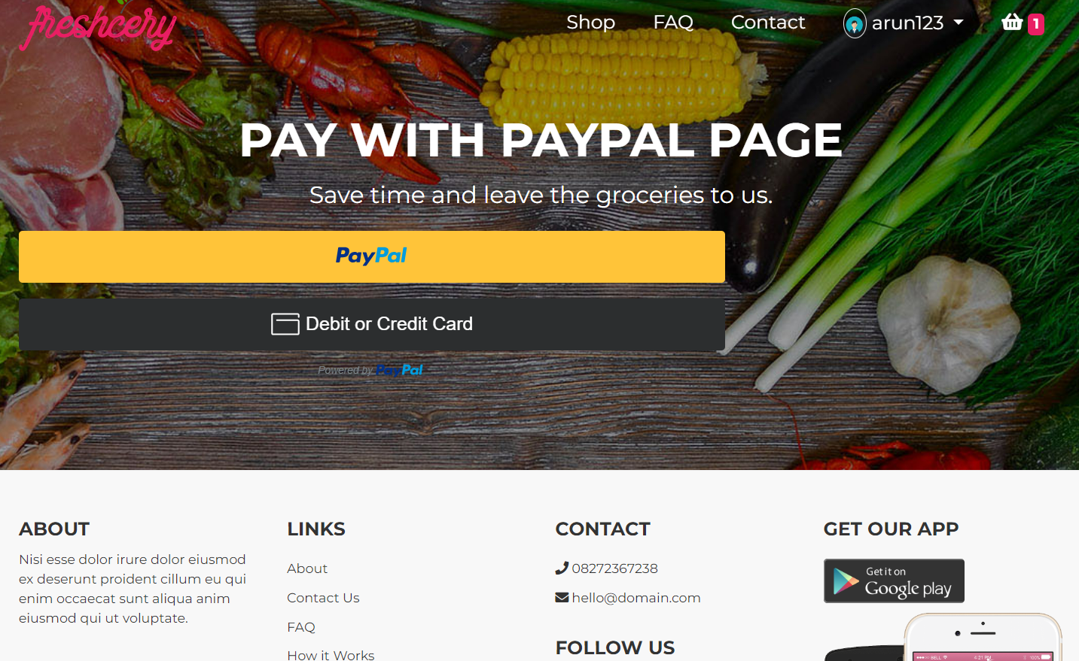
Fig 5: payment page

Slide 11
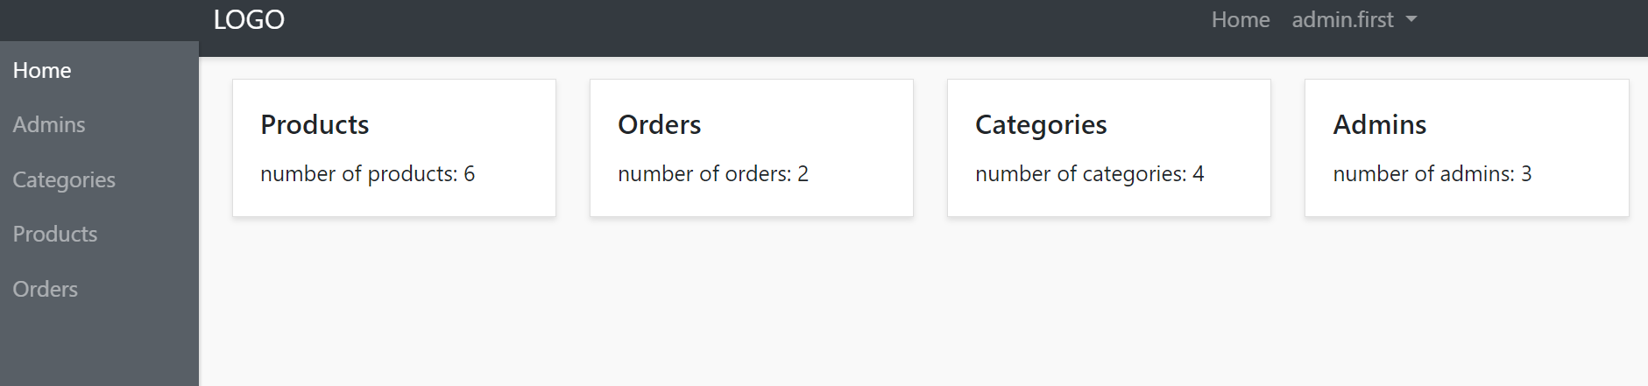
Fig 6: admin panel

Slide 12
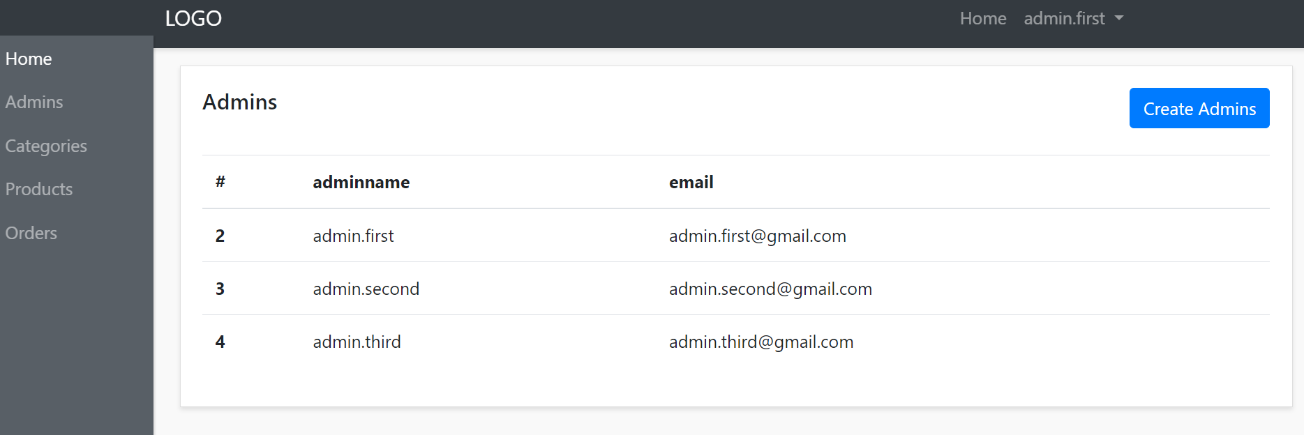
Fig 7: All admin page

Slide 13
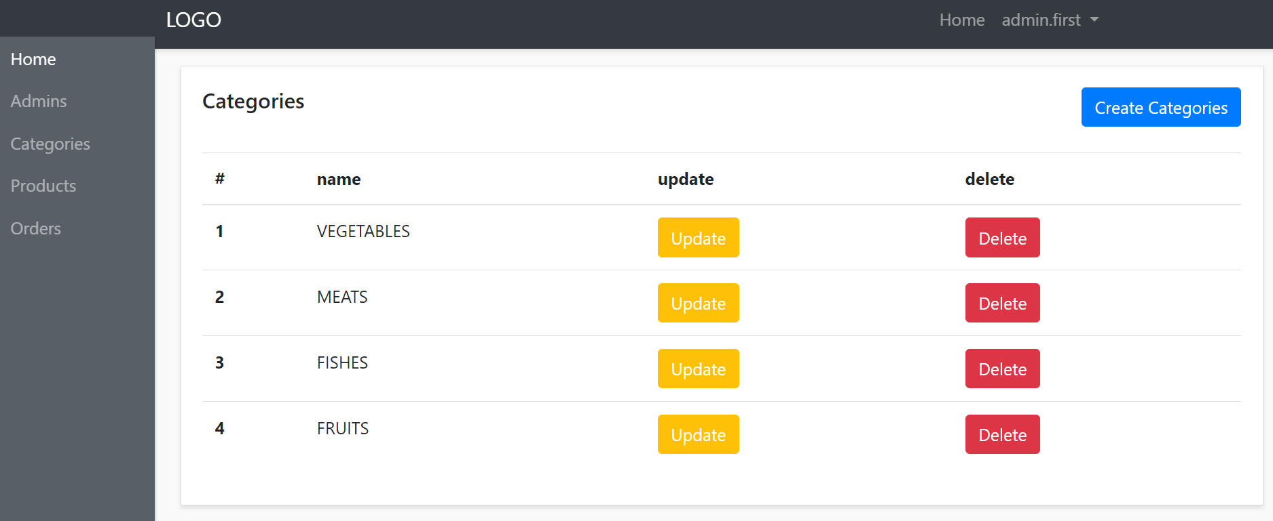
Fig 8: admin category page

Slide 14
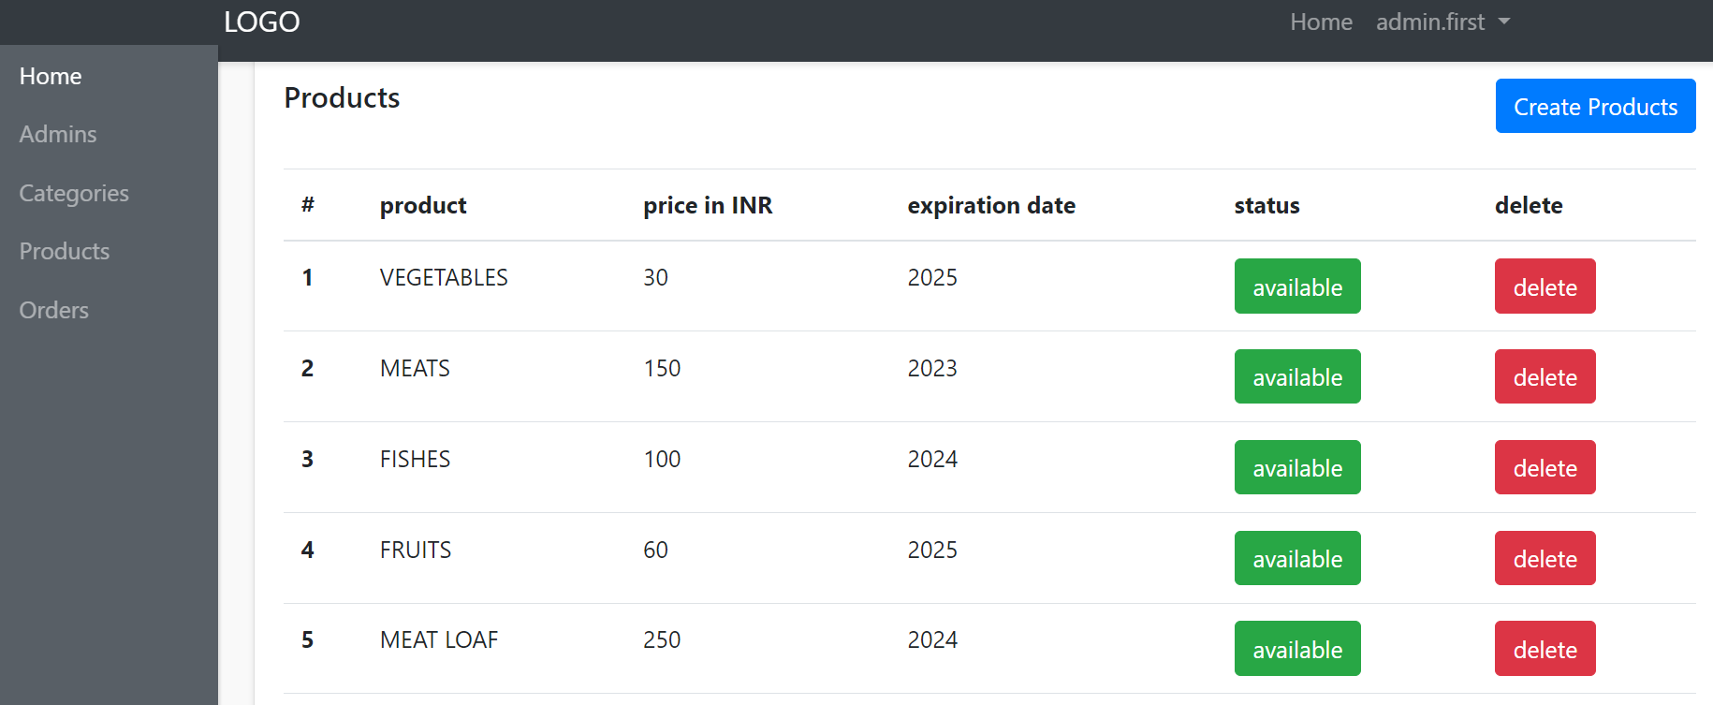
Fig 9: admin product page

Slide 15
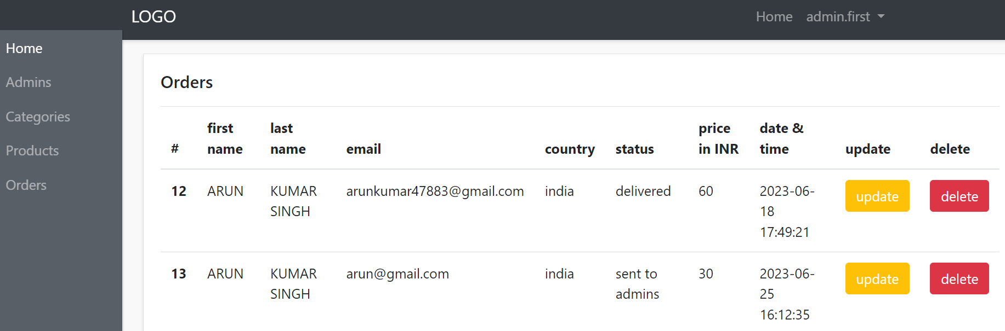
Fig 10: admin order page

Slide 16
Conclusion
FreshFood website has developed successfully using PHP, Ajax, HTML, CSS, and MySQL offers a dynamic and interactive user experience with efficient server-side processing, realtime data updates, responsive design, and seamless database integration.
It combines the power of PHP for server-side scripting, Ajax for asynchronous communication, HTML and CSS for flexible and appealing design, and MySQL for efficient data management. This comprehensive stack enables the creation of robust, feature-rich websites that meet the diverse needs of businesses and users.

Slide 17
THANK YOU

